Slide 1

AICT Lab Final Project
Muhammad Faizan - 11
Muhammad Hadi - 51
Muhammad Sagheer - 14
Abdul Rehman - 46
Abdullah - 10
Presented By:
Instructor:
Ramsha Khalid

Slide 2
Master the Art of Culinary Excellence
From Beginner to Professional Chef — Your Journey Starts Here

Slide 3
About Our Academy
A Professional Cooking Courses and Amazing Recipes Platform dedicated to teaching the art of cooking across all levels.

Slide 4


Who We Are
Legacy of Taste
We believe that cooking is more than just a task—it is an art form. Our platform provides a bridge between traditional culinary secrets and modern kitchen techniques.
Whether you are a home enthusiast or an aspiring Michelin-star chef, our structured curriculum is designed to help you excel.

Slide 5






Our Teaching Mission
Education
Artistry
Success
Providing high-quality cooking education that empowers students to cook confidently anywhere.
Encouraging creativity and precision through professional kitchen training and mentorship.
Enabling students to turn their culinary passion into a certified professional career.

Slide 6
Why Choose Culinara?
Expert Chefs: Learn from experienced chefs with years of real-world kitchen knowledge.
Flexible Timing: Learn at your own pace with schedules designed to fit your busy lifestyle.
All Skill Levels: Courses available from foundational basics to expert professional training.
Certification: Pass the test and earn a professional certificate after course completion.

Slide 7
Our Training Programs
Diverse modules designed to refine your skills in home cooking, baking, and professional management.

Slide 8

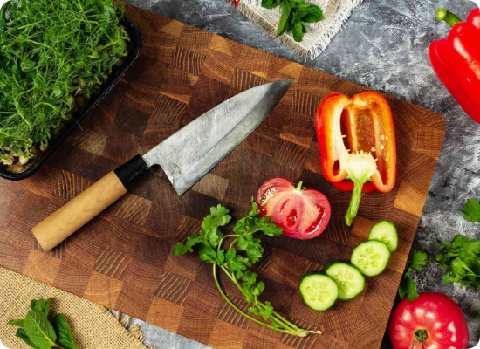
Basic Home Cooking
Foundation for Beginners
Perfect for those just starting! This course covers the essentials of healthy daily meals and foundational techniques.
•
Essential knife skills and safety.
•
Understanding fresh ingredients.
•
Simple, nutritious 30-minute meals.
Duration: 6 Weeks

Slide 9
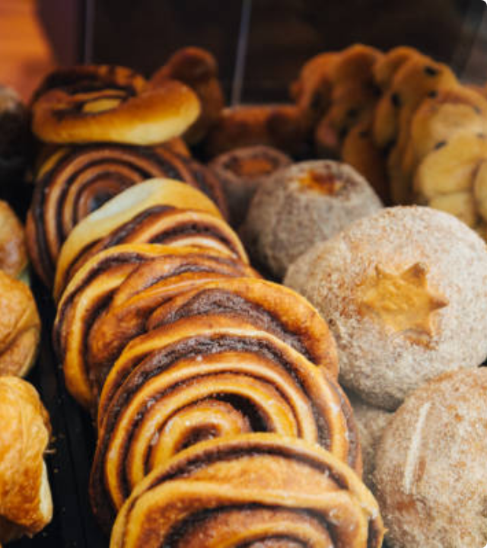
Baking & Desserts
The Science of Sweets
Master the delicate art of baking. From artisan breads to sophisticated French pastries, we teach you the chemistry behind the perfect rise and texture.
Artisan Bread Techniques
Delicate Pastry Science
Gourmet Plating for Desserts
Duration: 8 Weeks

Slide 10
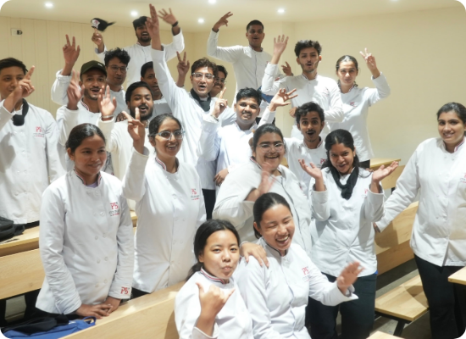

Professional Chef Program
Advanced Techniques
Designed for aspiring professional chefs. Learn gourmet plating, high-pressure kitchen management, and advanced global culinary arts.
Duration: 3 Months Intensive

Slide 11
Signature Recipes
Exploring authentic flavors from Pakistani classics to international favorites.

Slide 12

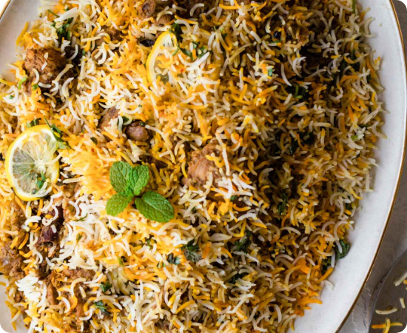
Desi Classics: Chicken Biryani
Authentic Dum Biryani
Master the aromatic blend of Basmati rice and marinated chicken. Learn the secret of the perfect "Dum" (steam cooking) that locks in flavor.
Ingredients: Basmati rice, Chicken, Biryani Masala, Yogurt, Fried Onions, Mint.
Method: Layering technique with slow steaming for 15 minutes.

Slide 13

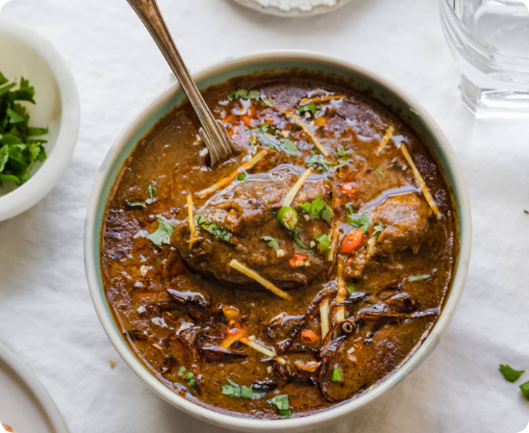
Slow Cook: Beef Nihari
Hearty & Rich
A masterpiece of slow cooking. Learn how to cook beef shank for 6 hours with a unique spice blend to achieve a silky, rich gravy.
Essentials: Beef shank, Wheat flour for thickening, Nihari Spices.
Garnish: Fresh ginger, lemon wedges, and green chilies.

Slide 14


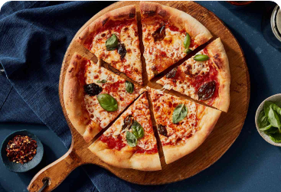


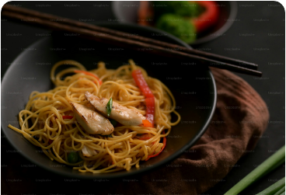
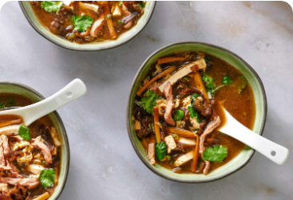
International Cuisines
Italian
Pan-Asian
Starters
Fresh Margherita Pizza
Chicken Chow Mein
Hot & Sour Soup

Slide 15

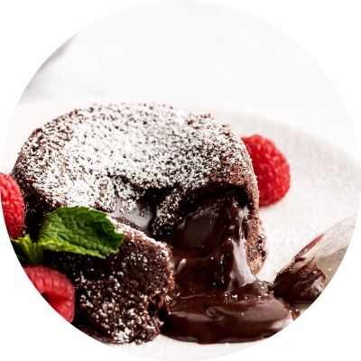
The Sweet Finale
Chocolate Lava Cake
The ultimate test of precision. Learn the exact timing needed to achieve a solid outer shell and a rich, molten chocolate center.
Bake: 180°C for 12 minutes.
Ingredients: Dark chocolate, butter, eggs, vanilla essence.

Slide 16
Course Overview & Comparison
Program Name | Target Audience | Key Skill Focus | Duration
Basic Home Cooking | Beginners | Knife Skills & Healthy Meals | 6 Weeks
Baking & Desserts | Enthusiasts | Pastry Science & Artisan Bread | 8 Weeks
Pro Chef Program | Professionals | Gourmet Plating & Management | 3 Months

Slide 17
Conclusion
Our academy is more than a school—it's a community where passion meets profession. We are dedicated to providing the skills that transform kitchens into stages for excellence.

